Slide 1

Developing Smart ML Based Recommendation System
Group No. 27
Sakshi Naik-17104059
Sayali Phowakande-17104060
Arjun Rajput-17104068
Project Guide and Coguide
Prof. Apeksha Mohite
Prof. Geetanjali Kalme

Slide 2
Contents
Introduction
Objectives
Problem Definition
Technological Stack
Review Suggestions (Given in Last meeting)
Proposed System Architecture/Working
Prototype Design Demonstration
Implementation Status
Status of Paper Draft & Targeted Conference

Slide 3
Introduction
Rapid development of mobile devices and internet has made possible for us to access different music resources freely.
Due to the increase in the number of mobile users, developing a Smart recommendation system can also increase the audience for the market which is based on music.
The reason behind developing the recommendation system is that it will help users to get personalized results.
Thus, there is a strong need of a good recommendation system.
Here we are developing a Smart Recommendation system which will recommend Music as well as video format of playing music, To make it more efficient we are integrating it with voice-assistant.

Slide 4
2. Objectives
To build Cross platform application
To build a hand-free application.
To keep a track of frequently played music.
To provide recommendations based on users’ preferences .
To provide suggestion for video link of played music.

Slide 5
Problem Definition
Problem Definition:
The number of music available exceeds the listening capacity of a single individual.
Therefore it is sometimes difficult to choose from millions of music.
Problem Solution:
To manage this user needs a recommendation system which can help their user to introduce new music by giving quality of recommendation.
Our system is developed as a music with its videos recommendation system that can give recommendations based on similarity and rating features.

Slide 6
Technology Stack
Frontend:
Flutter
Backend:
Firbase
BigQuery
TensorFlow
Algorithms :
Hybrid Algorithm ( Collaborative Filtering and content based )
AI Voice Assistant :DialogueFlow-Flutter Library
Chatbot : Using Rasa and Python

Slide 7
Review Suggestions (Given in Last meeting)
Target Standard Publication.
Objective should be clearer.
Modify implementation of chatbot.

Slide 8
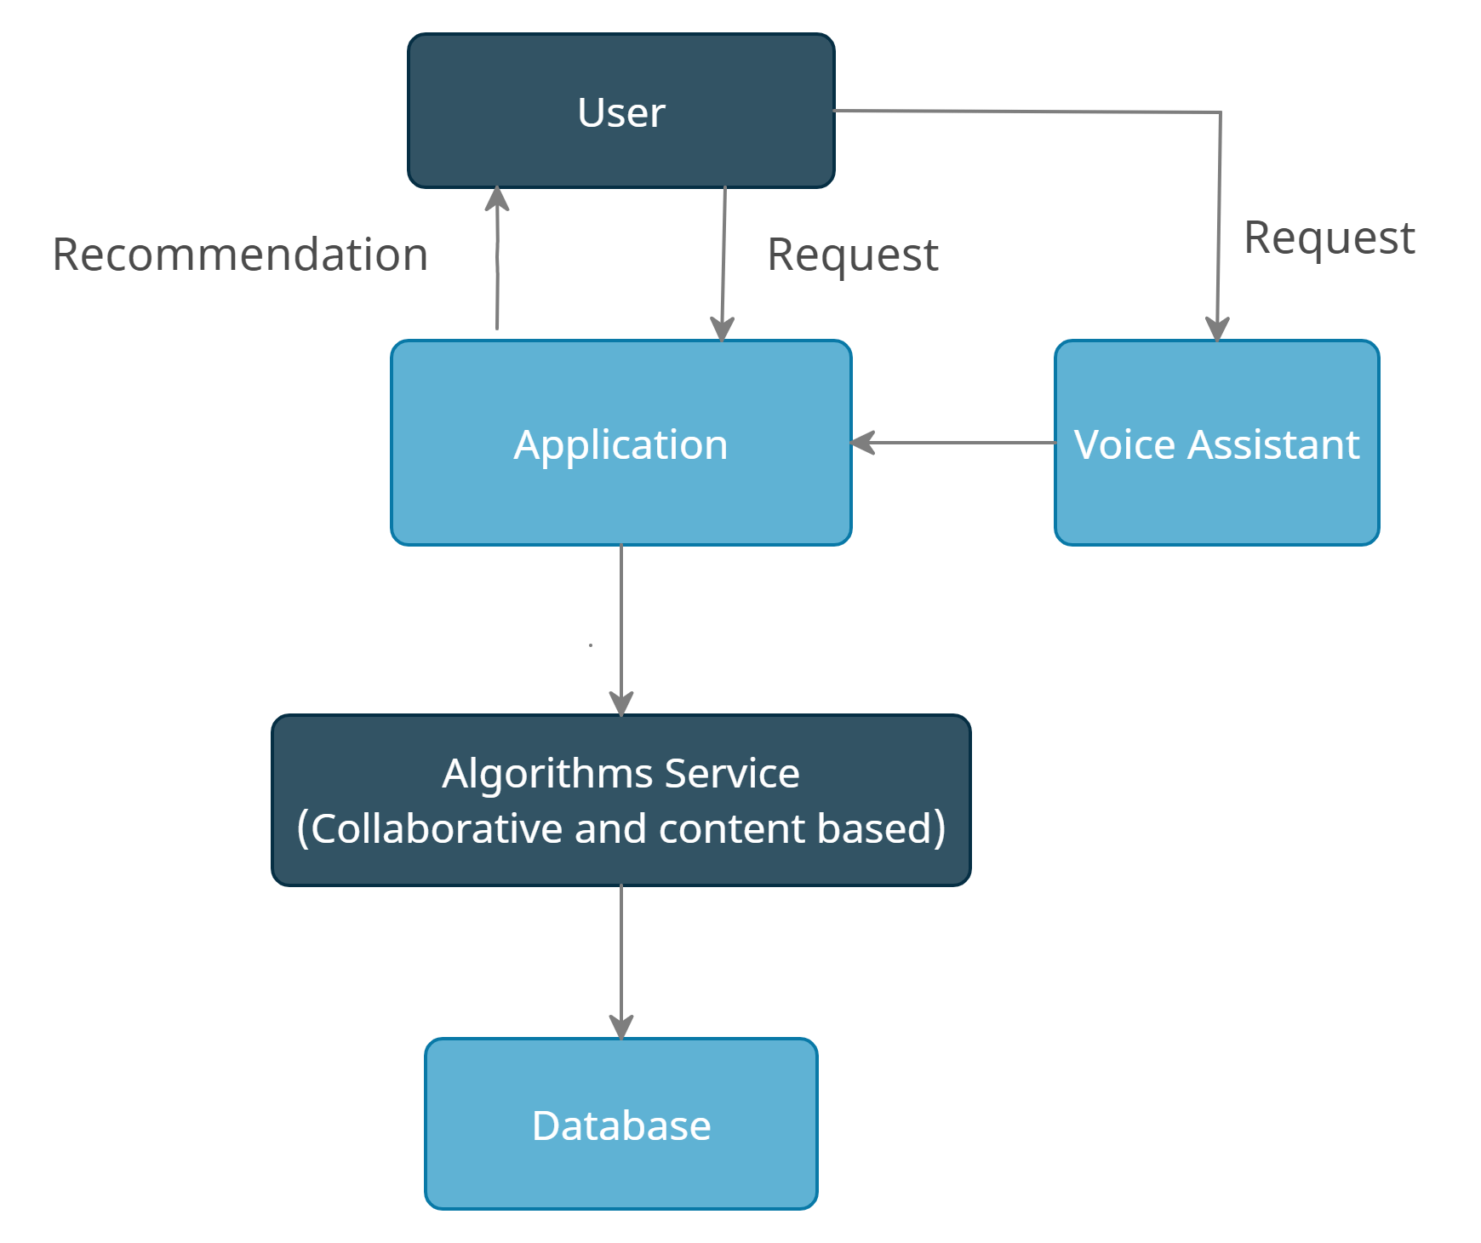
Block Diagram to propose project Idea

Slide 9
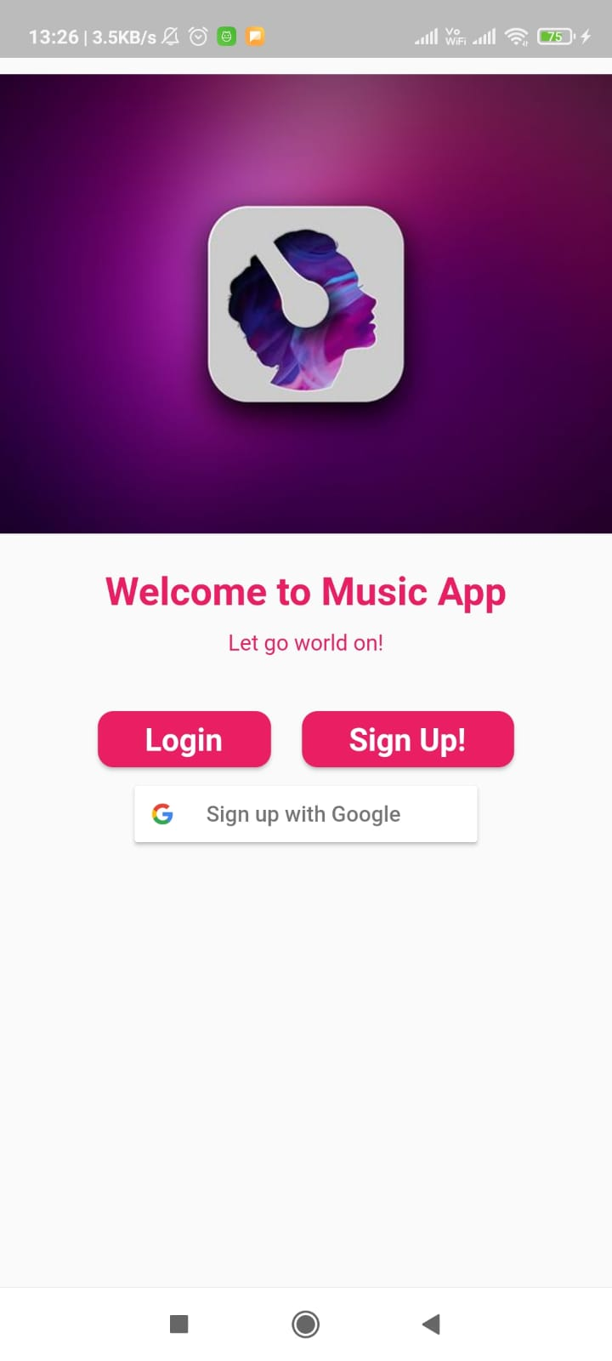
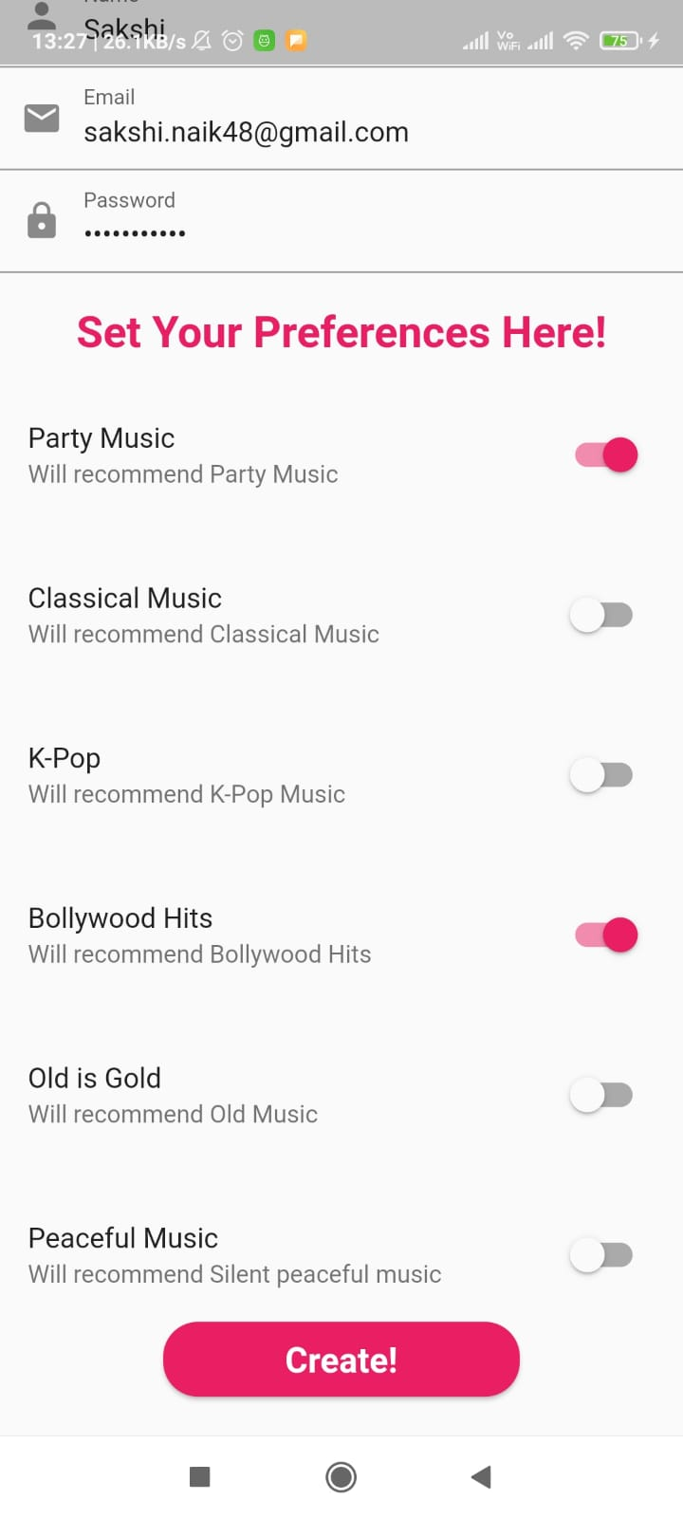
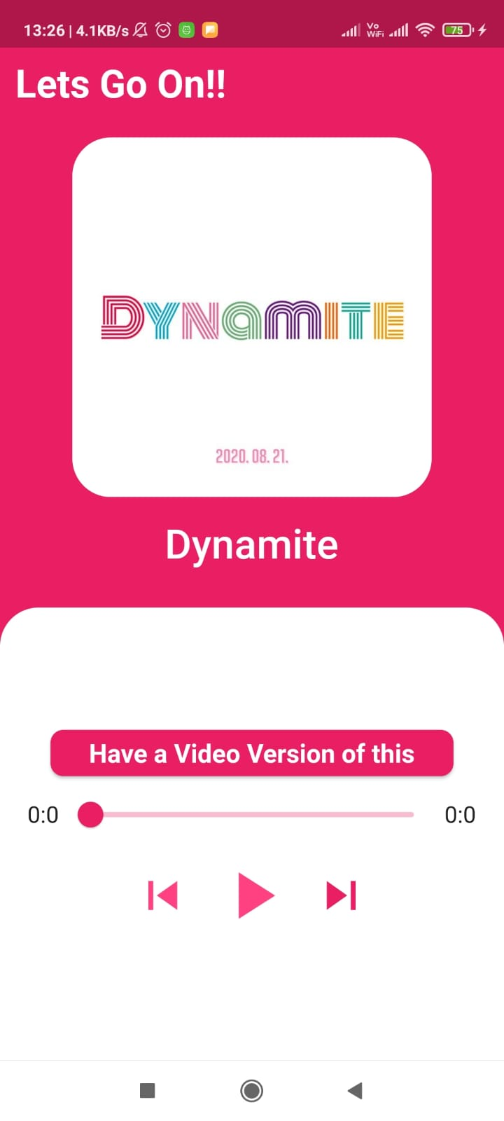
Prototype Design Demonstration

Slide 10
Implementation Status
Completed With Login and Sign Up UI for user with collecting their preference.
UI Music Player and Video Link Recommendation is being Done.
Firebase for Database is being created but while connecting it modules pages start rendering.
Aug-Sept’21
January’22

Slide 11
Publication
Submitted-3rd International Conference On Emerging Technologies In Data Mining And Information Security

Slide 12
Thank You...!!

